Slide 1
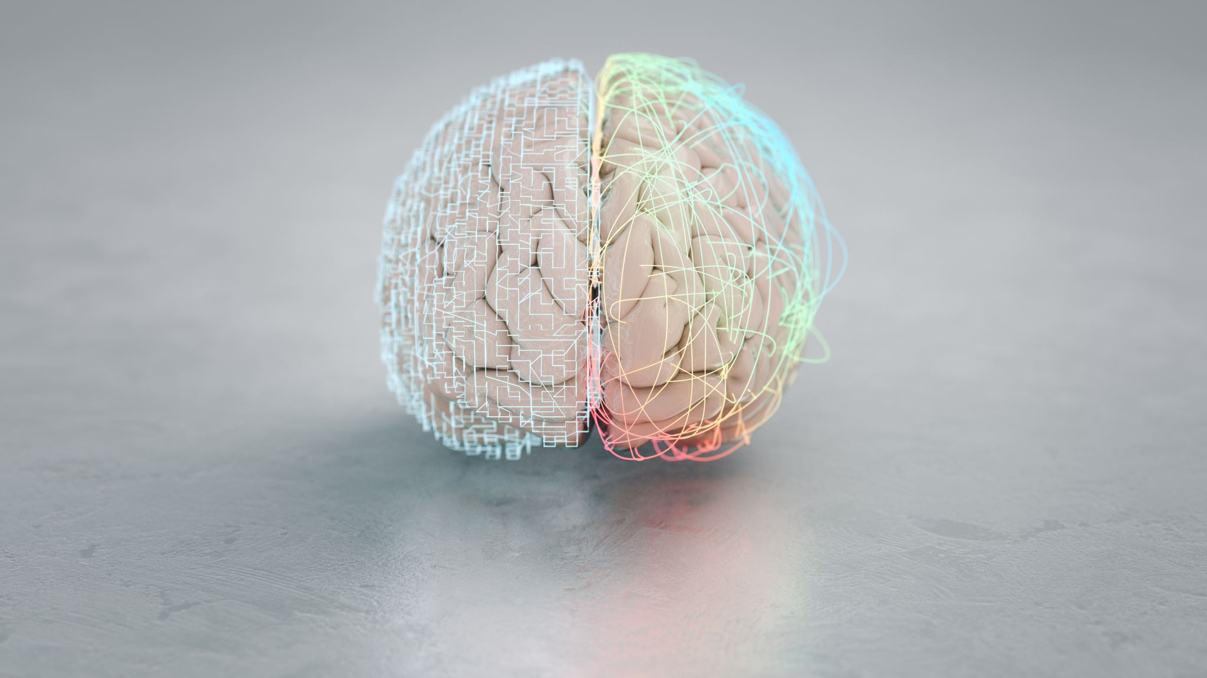
Adolescent Brain Development: Things to Consider Beyond the Pandemic
By Brandon Jones, M.A.
Executive Director and Consultant

Slide 2
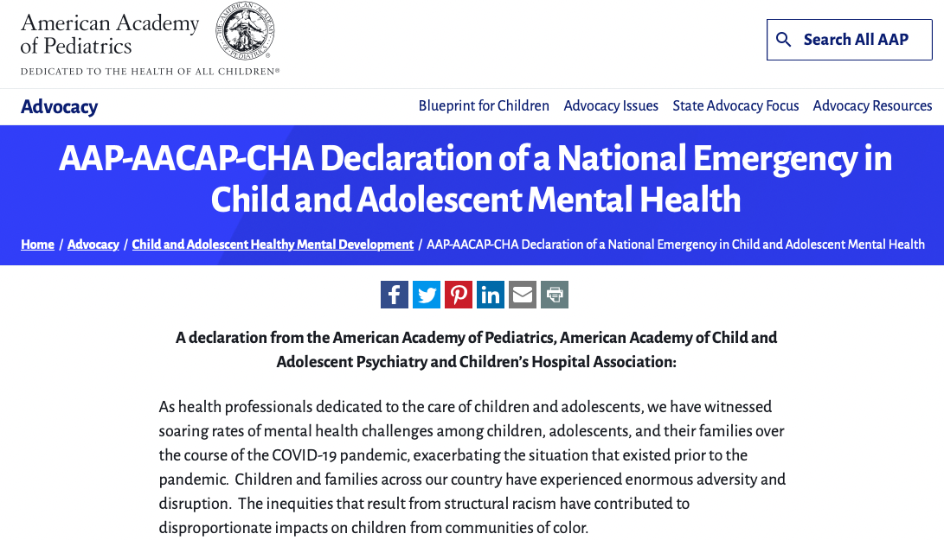

Slide 3
How Adolescents Think and Process Information
According to Piaget, the fourth and final stage of cognitive development, the formal operational stage, begins at about 11 years old
Characteristics of formal operational thought:
Abstract thinking and logical inferences
Verbal problem solving abilities
Enhanced focus on thought and its abstract qualities
Thought full of idealism and possibilities
Hypothetical-deductive reasoning, which involves creating a hypothesis and deducing its implications, which provide ways to test the hypothesis

Slide 4
Adolescent Information Processing
Adolescents’ abilities improve in several areas:
Executive function: goal-directed behavior and self-control
Working Memory
Cognitive Control: focusing attention, reducing interfering thoughts, and being cognitively flexible
Decision Making: generating more options, examining perspectives, anticipating consequences, and judging sources
Strongly influenced by emotional state and social context
Critical Thinking: thinking reflectively and productively, and evaluating evidence
Metacognition

Slide 5
Adolescents’ Values
Values are beliefs and attitudes about the way things should be
Individuals attach values to politics, religion, money, sex, education, helping others, family, friends, career, cheating, self-respect, etc.
Over the past four decades, college students have shown a greater concern for their own well-being
Today, U.S. college students may be shifting again toward a stronger interest in the welfare of the larger society

Slide 6
Moral Development
Post-conventional reasoning (Kohlberg) has recently appeared to be declining in college students
Prosocial behavior, however, increases in adolescence
Forgiveness: an aspect of prosocial behavior that occurs when an injured person releases the injurer from possible behavioral retaliation
Gratitude: a feeling of thankfulness and appreciation

Slide 7
What is Trauma?
A DEEP EMOTIONAL WOUND!
Which is closely connected to Toxic Stress or Toxic Environments

Slide 8
Languishing
Languishing is a sense of stagnation and emptiness. It feels as if you’re muddling through your days, looking at your life through a foggy windshield. And it might be the dominant emotion of 2021.
According to the New Times

Slide 9
We Are In A State Of Grief!
WE HAVE LOST THE FOLLOWING…
Access
Our “Normal” Routine
The Ability Of Choice
Connections
Opportunities
LIVES OF Loved ONES
THIS IS WHAT WE CALL AMBIGUOUS LOSS

Slide 10
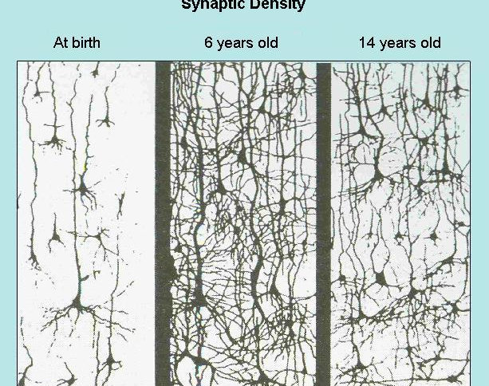
Synaptic Density Pruning
Process Of Pruning - At age 14 you will notice that there are now fewer connections between the brain cells than there were at age 6. This is because the least "experienced" connections tend to withdraw at about the time of puberty.

Slide 11
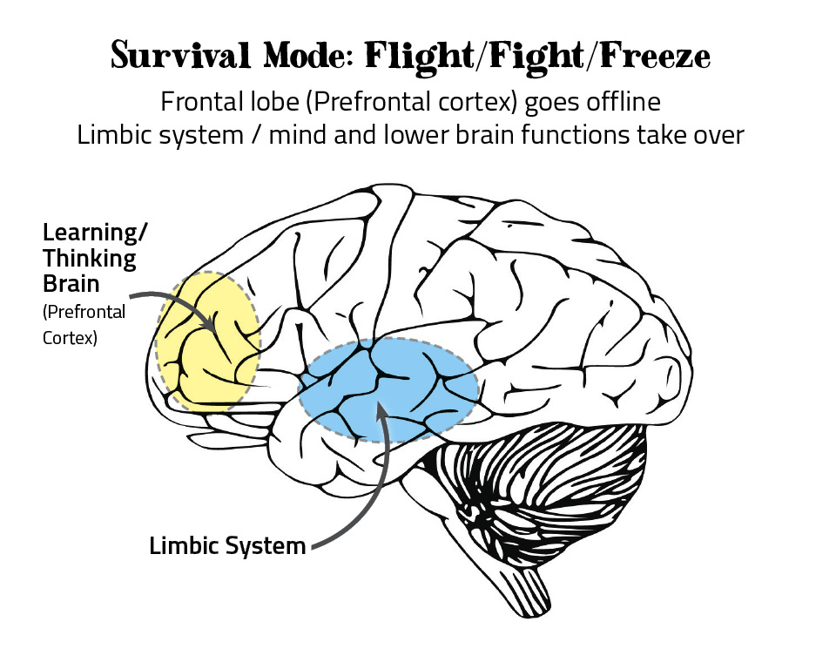
Toxic Stress
Child experiences traumatic event
“Fight or flight” response activated
Limbic system activates; stress hormones released as response to fear or anxiety
Toxic stress can literally shape an anxious/ fearful brain that acts first and thinks later.
Normally responsible for regulation of thought, behavior and emotions
Frequent exposure to stressful, scary situations lead to toxic levels of stress of the child
Limited brain development: stress regulation, decision making
Inability to distinguish what is safe
Impaired memory, concentration, learning ability
Fight or flight response activated: stress hormones released, fast reflexive responses

Slide 12
Survival Stress Management
A process of adapting to stressful situations by acting or reacting without thinking of the consequences of our choices; immediate satisfaction or instant self-gratification; resulting in increased stress and/or depression:
Judgmental and distorted thoughts and feelings, impatience, exploitation, aggression, abuse and violence directed against oneself or others.
Addictive substances and behavior (i.e., drugs, alcohol, sex, shopping, fast money, gambling, food, video games, etc.) produces a limited sense of relief requires repetitions.

Slide 13
Healing is…
A consistent process of efforts to create peace, balance, and justice.

Slide 14
What Does Mental Health Justice Mean To You?
People: Communities and individuals must refuse the denial (that things are “okay”) and confront the stigma of Mental Health, feel comfortable enough to seek professional help, and be willing to change patterns in their lives to be better.
Institutions: The Mental Health Systems must have treatment services that meet the cultural needs of communities and resources to address the continuum of mental health needs. “Those that need the most help get the most help.”

Slide 15
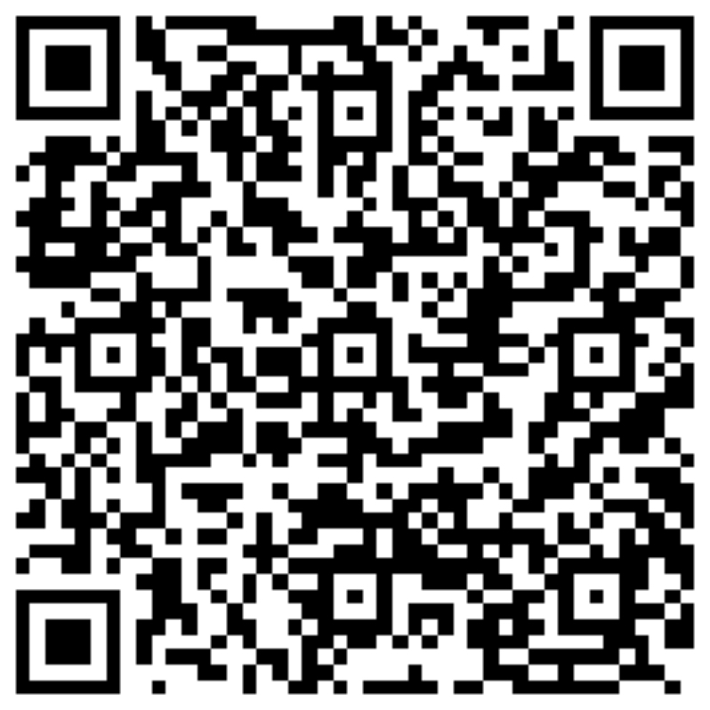
Contact Information
Brandon Jones, M.A.
Email: bjones@macmh.org
Website: www.macmh.org

